Slide 1

GROCERY DELIVERY WEBSITE

Slide 2
GROCERY DELIVERY WEBSITE
A grocery delivery service is a platform through which groceries can be delivered to customers at their homes or a central pickup location. With grocery delivery services, you can place orders and make payments for various items online.
LMS Username | Name | Batch
2115a917 | DHARANI.R | A9
2115a923 | HARINI.B | A9
2115a926 | JANANI.G | A9
2115a927 | JANANI.G | A9

Slide 3
Step-Wise Description
Purpose
Grocery Shop Management System is based on a concept of making grocery orders from customers to providers. The purpose of this system is basically connect the providers and customers in a large platform where provider can increase their sell so fast and customers can buy their desire product from home which will also consume time and make the life easier. On a web-based marketplace, each small business receives a greater exposure, than when operating alone, which in turn provides a greater opportunity for increased sales. Besides, customers also wants many option before buying any product and want to order from home. So eventually, providers can reach to the bigger number of customers and customers can reach to a big number of grocery shops as well through this platform instantly from anywhere.
Deliberate Audience
Our intended Audience is: • Providers • Customers
Deliberate Use:
This website is o work effectively. intended for the customer who are willing to buy product through online want many alternatives and want to save their time as well. Also for the providers who have grocery shop and who are willing to increase their sale or gain more market exposure. The rest of the SRS contains every details required for the software .

Slide 4
Product Scope :
Grocery Shop Management System is a single platform for different grocery shops to enhance their sale. Different grocery shop will offer their products. In this application the customer can login, select products, quantity and proceed towards confirm order. After confirming the order grocery provider will get a notification of order and he will start going to customers location with the grocery container(vehicle). Payment method will be cash on delivery. This website will give the companies a greater exposure to their products.
Classes and Characteristics Of Users :
There will be three types of users in the system there are Admins, Shop owners and customers. First of all, the admin will have control and knowledge over the entire system. They can directly monitor the customer’s tasks and shipowner’s tasks and also approve requests and products. They can add and remove products as well. The shop owner got access to the shop information and has privilege to update it as well. The shop owner will be able to see shops current order request and can accept and cancel the request and also, they can see all order done information. Along with ordering food stuff online, the customers can view their personal information and update it in need. They can view which orders are pending and which are received.

Slide 5
Needs Of User
We are basically building this system in order to help people do online grocery shopping without needing to go out for shopping in this corona pandemic which is going to be fast and affordable. In the recent time in online shopping systems it takes a lot of time delivering the order to the customer as a certain delivery man goes to the shop then buy stuff and then finally deliver it which seems like a long process and requires quite a lot of time, Therefore, we have built a fast and affordable portable online shopping system where a vehicle with groceries will be there in all over the residential area by which the customers can get their ordered items faster than ever as the vehicle which is like a shop itself will reach the spot directly. Well first of all, Customers should need the information before they consume anything from the system. Our Web-application shall contain detailed information about the product, price, availability, physical shop Address. Searching Shop: Customer can search nearer available shop by giving location can Gate all details of the shop with product availability. Give Orders: Then using nearer shop personal id with product list customer can give Order. Customer info: Customer can see his personal info. Order received: Till now received order of that customer will be shown. Order running: Till now running order will be shown once the order has done then automatically the order will be shift on received order. Update Info: Customer can update his/her info. Logout: Customer can log out.
Development responsibilities:
Operating environment for the online grocery shopping is listed below: • Distributed database: MySQL. • Operating system: Windows/ Linux/ MAC. • Back-end: Php. • Front-end: HTML, CSS, JavaScript.

Slide 6
Constraints:
The user needs to log in/resister first with an personal email and password of their own.A computer or a smart phone device will be needed to access the site.
Assumptions
As online grocery shopping will be a web based platform, so a good internet connection will be required to access the website. It will be assumed that the users will possess good internet connectivity. Also, it is assumed that the user is familiar with the usage of smartphone as smart phone access will be needed. Users will have to register using email address, so it is assumed that the will have one. The user interface will be in Basic English, so it is assumed that the user will have basic knowledge of English.
Functional Requirements
User Registration
There shall be two different options in the homepage: Registration, and Login. To log into the system or buy any goods from the system, A user must finish his or her registration first. Initial Requirement The user both shop owner and customer must provide the first name, last name, email address, user name retype password and password. Furthermore, the user must confirm their email and password. Nevertheless, if there have many usernames in one name, then the user needs to change his or her username. The registration information is stored on the database and in future the user will be logged in by providing email and password.

Slide 7
Confirmation
There should be a few confirmation or pop up notification in the page. For example, Success – registered account and refer to login page. • Registration completed successfully. Failure – display message: • “Email address in wrong format”. • “Your passwords did not match, please try again”. • "Please give your email first". • "You did not submit your password". • "You should choose your username”. • “This user name is already exists ”
Shop Registration & Shop Page
The shop owner will have to register as user first, the user registration procedure in shown above and can get access after within some seconds by adimin. Once the user registration is done and logged in to the system then the shop will automatically registered including name .

Slide 8
Requirements & Description
The user must provide his shop’s name, address, contact number and category of products that can be purchased from the shop. Moreover, the shop owner should provide shop license for security purposes. Once the registration is done the information will be stored in the data base and a shop page will be opened. Here, the user can add his product details, pictures, price and stock. The user (shop owner) can add multiple products and all the information will be stored in the database. This information can be edited and removed any time by the shop owner. Stock updates will have to be given by the owner regularly. Once a product stock finishes, the system will automatically show in the window the product is stocked out to the customer. The shop page will view shop details and products to the customer. When the shop owner will log in the shop page will show edit information, add product, edit product and remove product in his dashboard panel
Product CRUD
Description
Enabling the shop owners to add product to the platform is an essential function of the software. While doing so they should be given the opportunity to update and delete their products if necessary. That’s why we need a CRUD operation on the product entity.
Product Search
There will be a search function in the homepage, where the user can search his desired product and shop, he wants to look at. The search function will take the input from user and filter out the product or shop and will view it to the user. Similar product to the searched product will be also shown. If any product is not available than the page will pop out “Product not found” or “Shop not found”. Customer can give review after shopping.

Slide 9
Shop search
Description Customer can search nearer shop through searching with location then can get all the information of the shop.
Product Update
Description :Shop owner can update his information including product stock with price at any time. Operations • Add Product • Remove Product • Update Quantity.
Customer Verification
Description When to register as customer first, the customer register and can get access after within some seconds by admin. Whenever any transaction is going to take place involving this website, the shop owners must verify the customer. If the customer is not verified, there can be fraud usage. Operation The shop owner will search for the customer profile. After finding them profile, the shop owner will send a verification email or number to the customers contact number or email. As soon as the customer is verified, the transaction can be completed. Stimulus/Response Sequences Both user customer/shop owner can get the order running, order done of their profile at a time and get the response instant.

Slide 10
Admin View:
Description
Admin can get the view of all transaction, profiles, reviews and information of both customer and shop.
Non Functional Requirements
Security Requirements
Security requirements of the system:
Encrypt users’ private information
Encrypt payment information
Showing the right content to the right audience.
Ethical Requirements :
Ethical requirements of the system:
Giving all shop owners equal and fair chance to promote and sell their products.
Giving customers their deserved amount of points.
Keeping customer purchase history private.
Performance:
Based on the performance the requirements of the system:
Fast Response Time for User Login the average response time for user login after entering user name and password should be no more than 3 sec and the maximum response time should be 10 seconds.
Maximum people should be able to concurrently visit the website.

Slide 11
Cost and time scheduling :
The grocery delivery website should be implemented within 5 months after designing the website.
The cost estimation for the system is 3 lakhs.

Slide 12
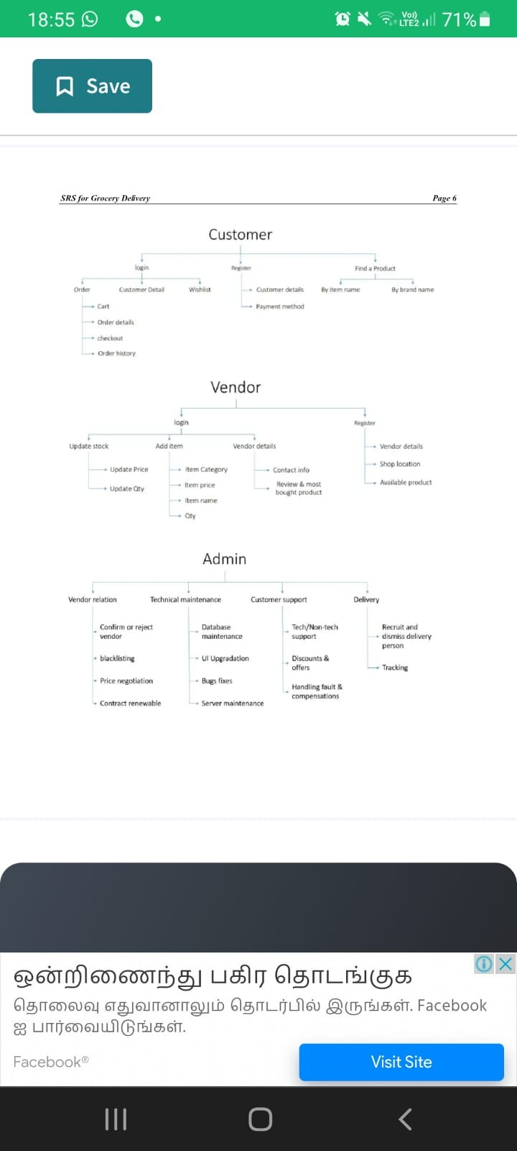

Slide 13
Submission Github
https://github.com/DHARU301/grocerysrs.git

